Slide 1
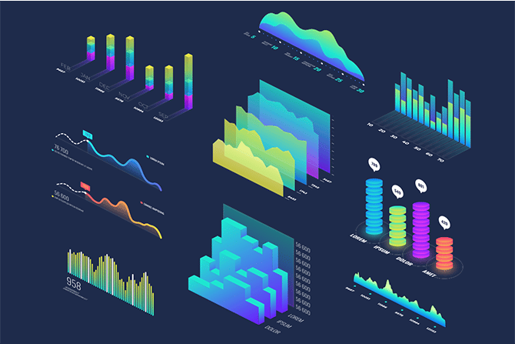

Data Visualization
Chapter 1: Introduction
Dr. Ghayth Almahadin
Faculty of Information Technology
Mutah University

Slide 2
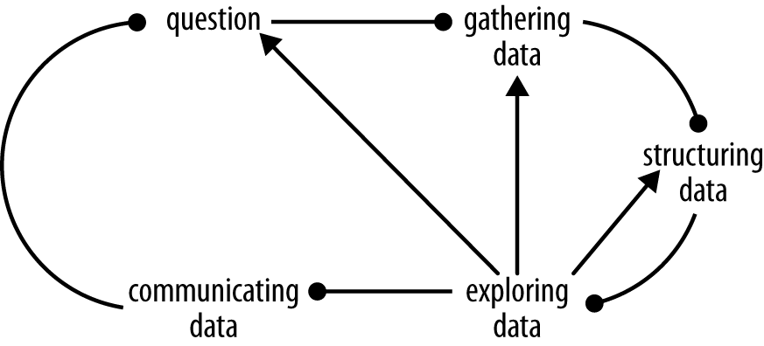
Definition
Data visualization is a graphical representation of data, which make it easier for users to identify patterns and understand difficult concepts.
Communicating data is a special case of communicating in general, which incorporates quantitative statements about the universe.
In this context, we are not using the word "data" in the general sense of factual information, but the "information in numerical form that can be digitally transmitted or processed".
Communication is a step in Data Discovery Process
Figure 1-1: The Data Discovery Process
Data Visualization
Notes:
During research and discovery, we empathize and gain new perspectives. We explore context and develop insights. Analysis brings all of this together to form conclusions

Slide 3
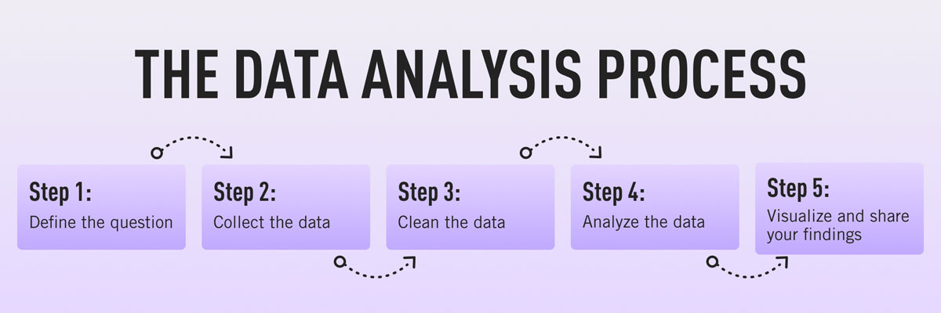
Definition
Data visualization usually comprises the final step in the data analysis process. To recap, the data analysis process can be set out as follows:
Data Visualization

Slide 4
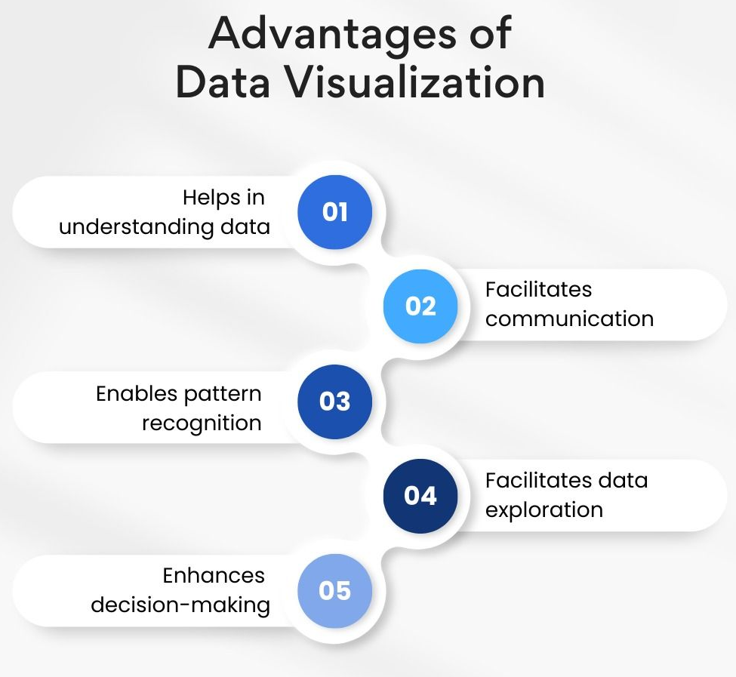
Significances
The Importance of Data Visualization
Understanding & Make Decision: Visualized data makes the data more valuable because it is easier to consume as information, which in turn becomes knowledge.
Communication: Visual metaphors are a universal language, allows people of any languages to communicate.
Exploration: Visuals are more effective than text. Visuals convey information more quickly than a large spreadsheet or densely written report.
Patterns: Visualized data increases knowledge.
Data Visualization

Slide 5
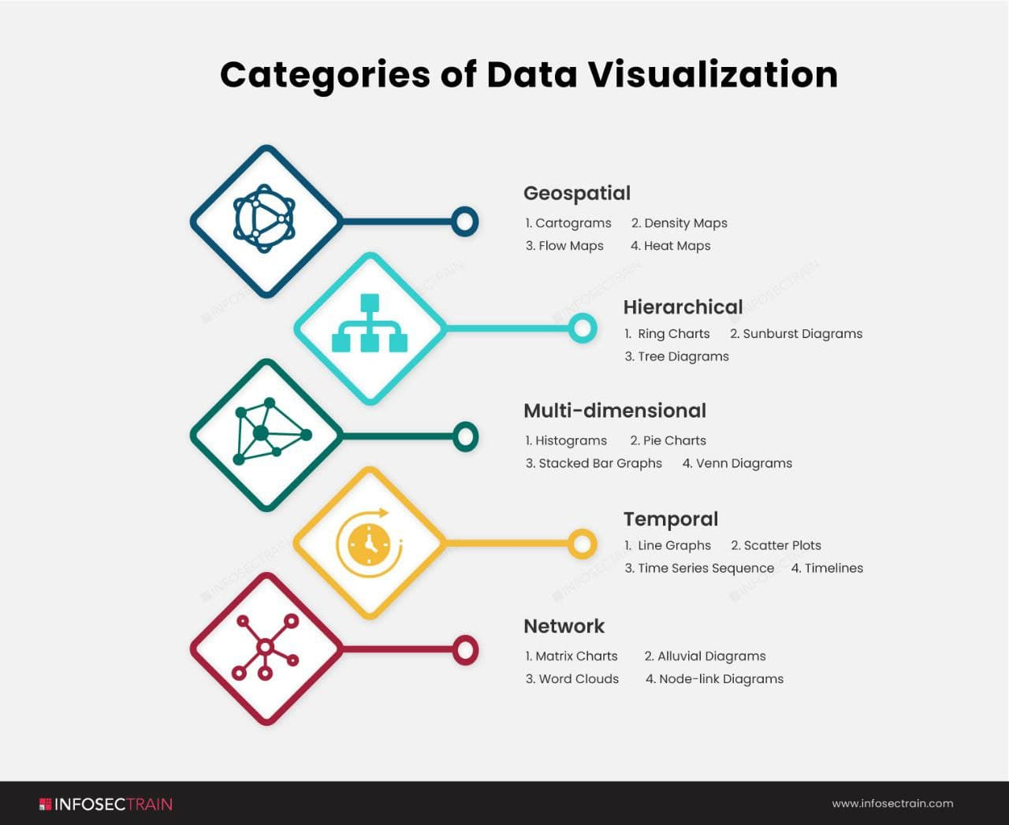
Categories
Data Visualization Categories
Geospatial visualizations: convey various data points in relation to physical, real-world locations.
Hierarchical visualizations: organize groups within larger groups, and are often used to display clusters of information.
Multidimensional or 3D visualizations: used to depict two or more variables.
Temporal data visualizations: linear and one-dimensional.
Network visualizations: show the relationships and connections between multiple datasets.
Data Visualization
Notes:
(for example, voting patterns across a certain country).

Slide 6
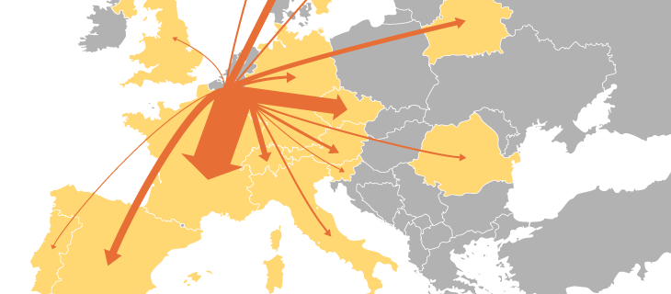
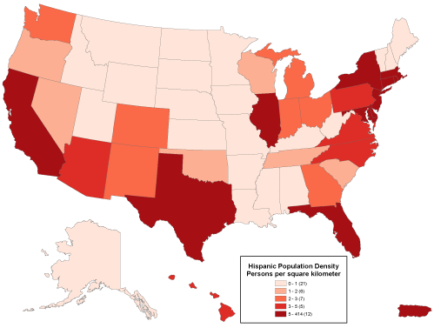
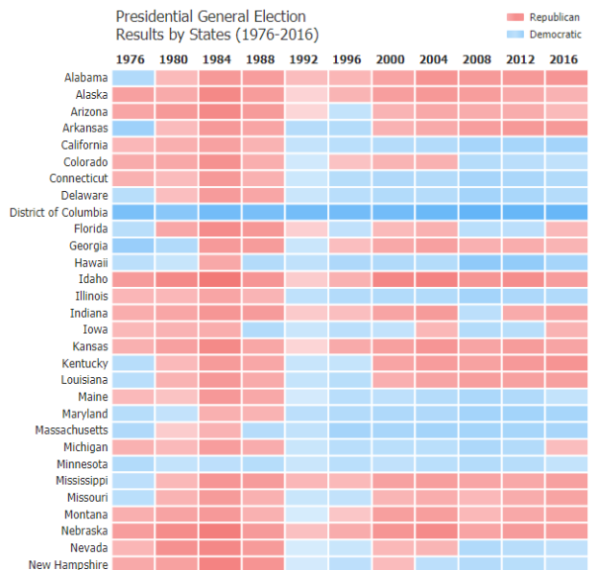
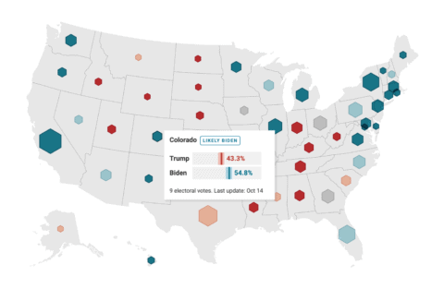
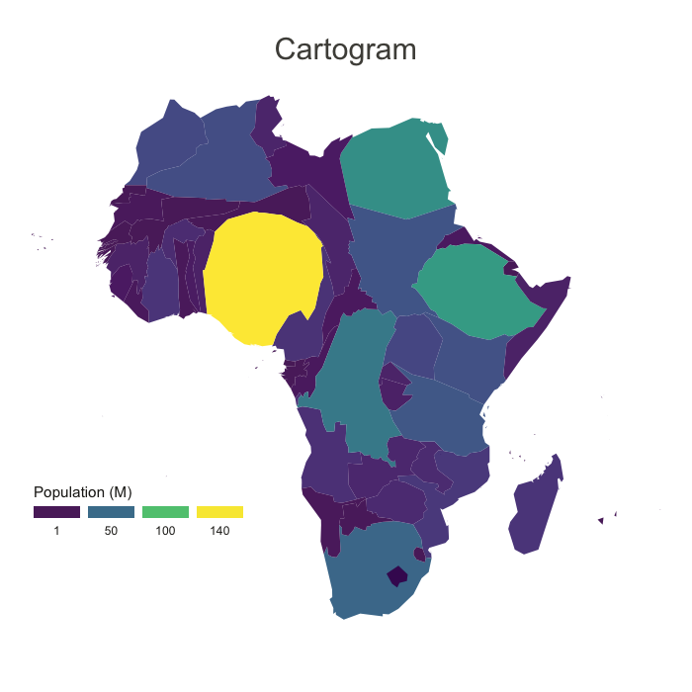
Categories
Geospatial Data Visualizations
Geospatial (or spatial) visualizations overlay familiar maps with data points. Geospatial data visualizations have a long history, too, as it was used for navigation before computational analysis came along.
Examples of geospatial data visualizations
Flow map
Density map
Cartogram
Heat-map
Symbol map
Flow map
Density
Heatmap
Cartogram
Symbol map
Data Visualization

Slide 7
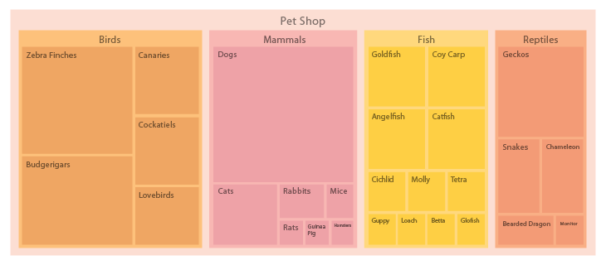
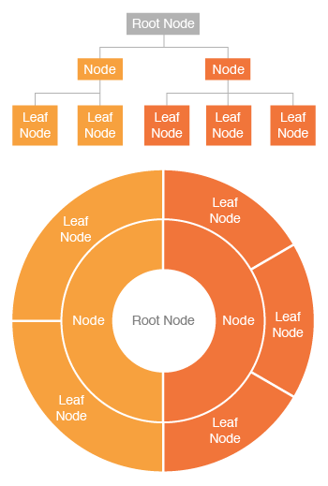
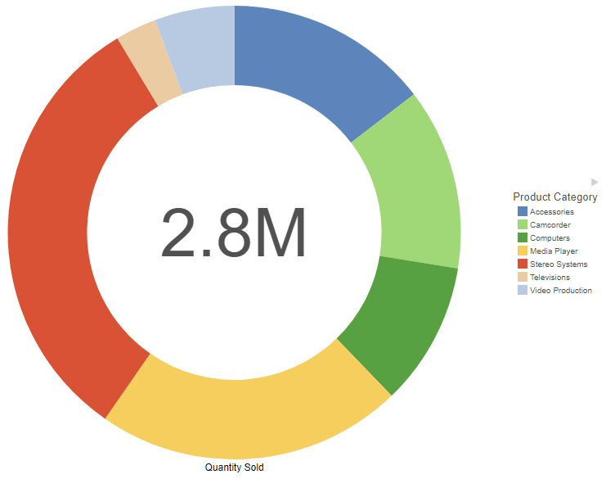
Categories
Hierarchical Data Visualizations
Order a collection of items that link back to a parent item (used to display a cluster of information, especially if it flows from a single origin point).
Examples of hierarchical data visualizations
Tree map or diagram
Ring charts
Sunburst diagrams
Tree map
Ring
Sunburst
Data Visualization

Slide 8
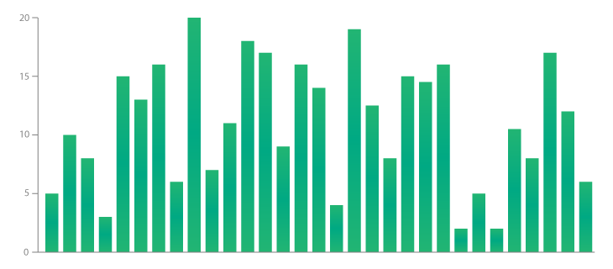
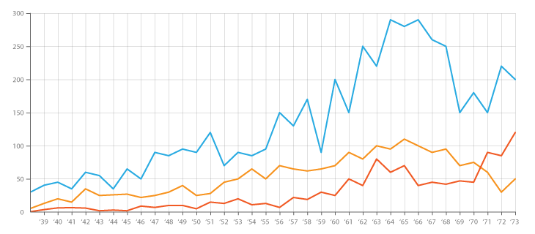
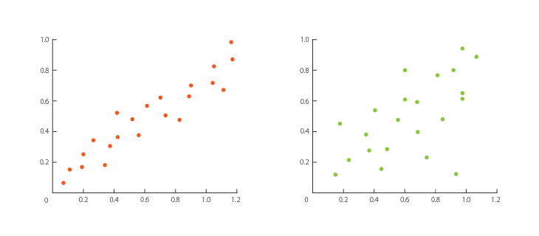
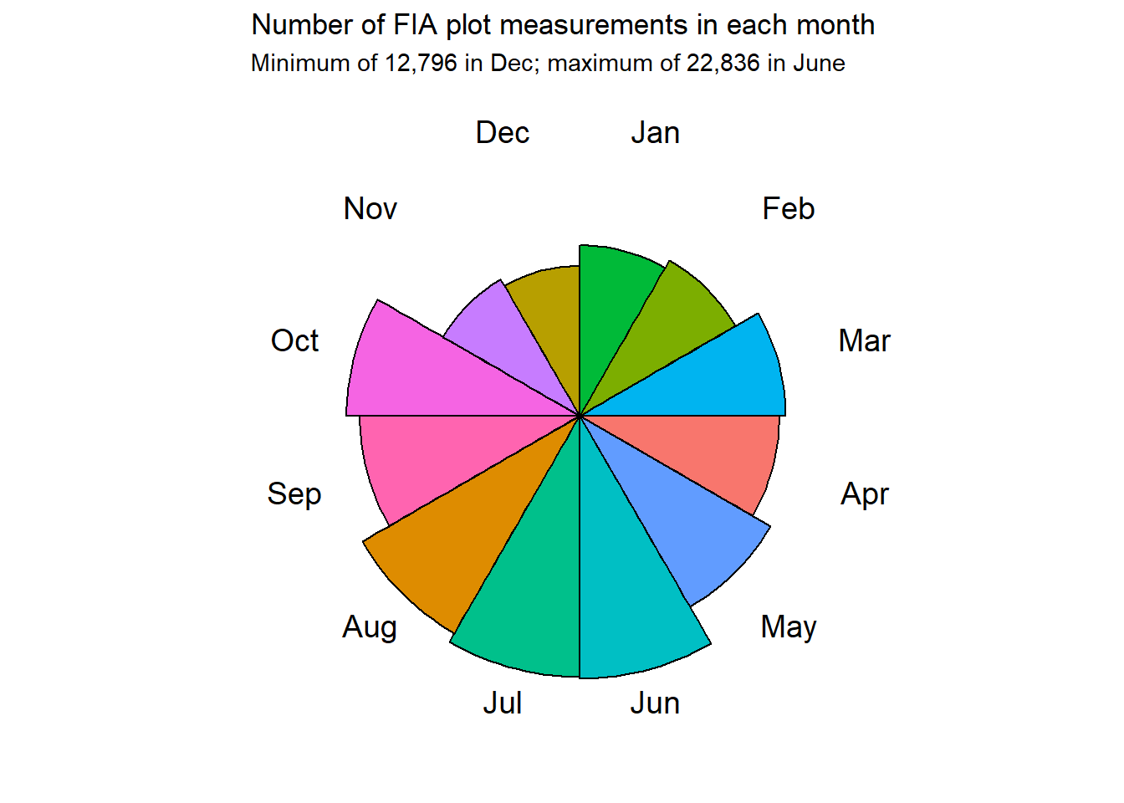
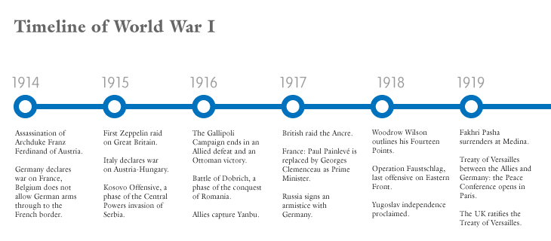
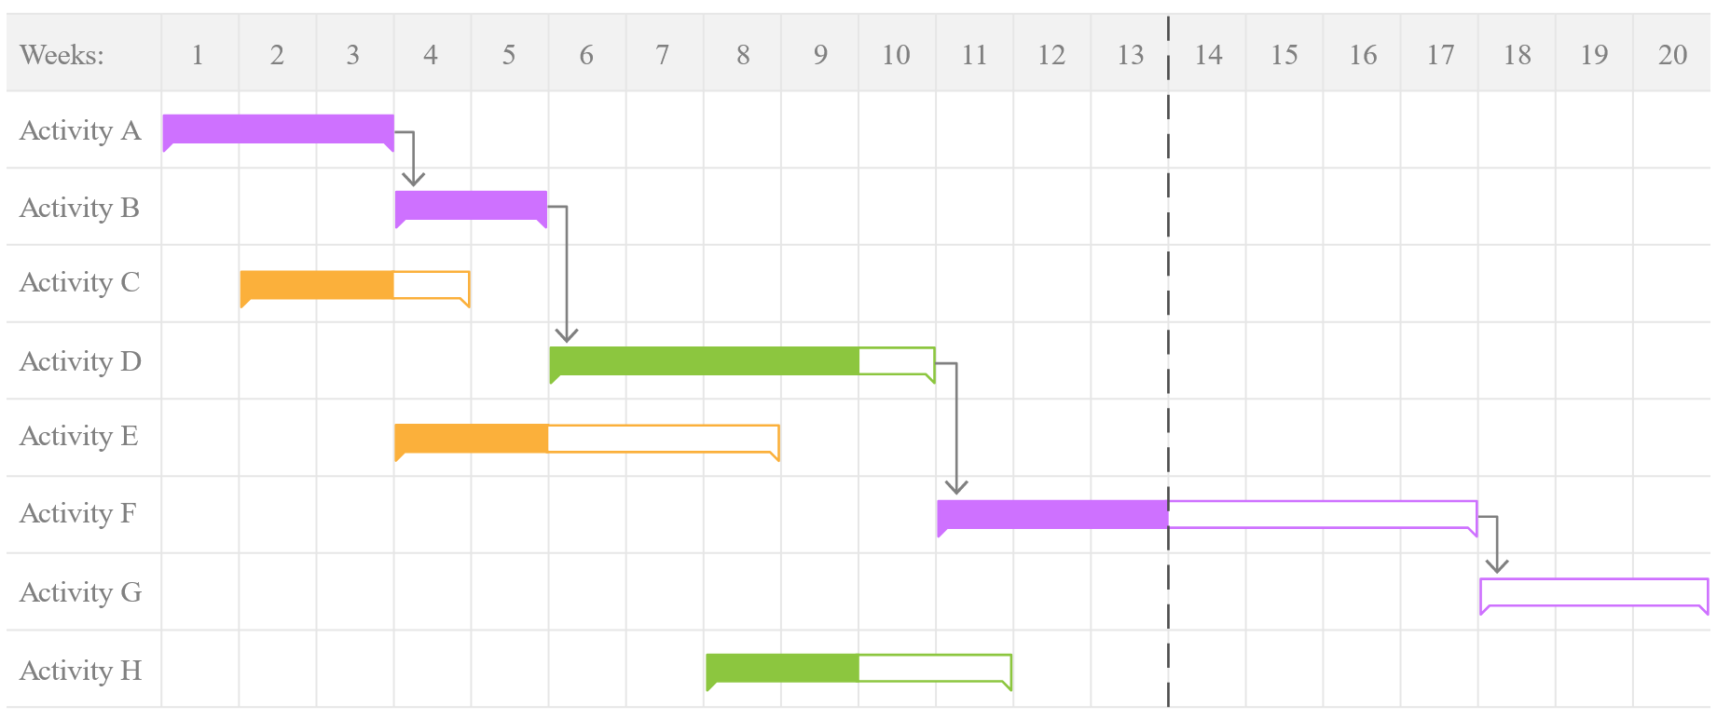
Categories
Temporal Data Visualization
Commonly used to show information like housing market fluctuations or visualize gains and losses.
Examples of temporal data visualizations
Bar chart
Line chart
Scatter plots
Polar area diagram
Time series sequence (Line chart)
Timelines
Gantt chart
Bar chart
Line chart
Polar area
Scatter
Gantt
Timelines
Data Visualization

Slide 9
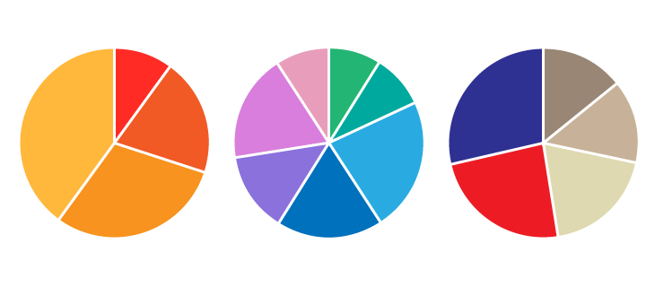
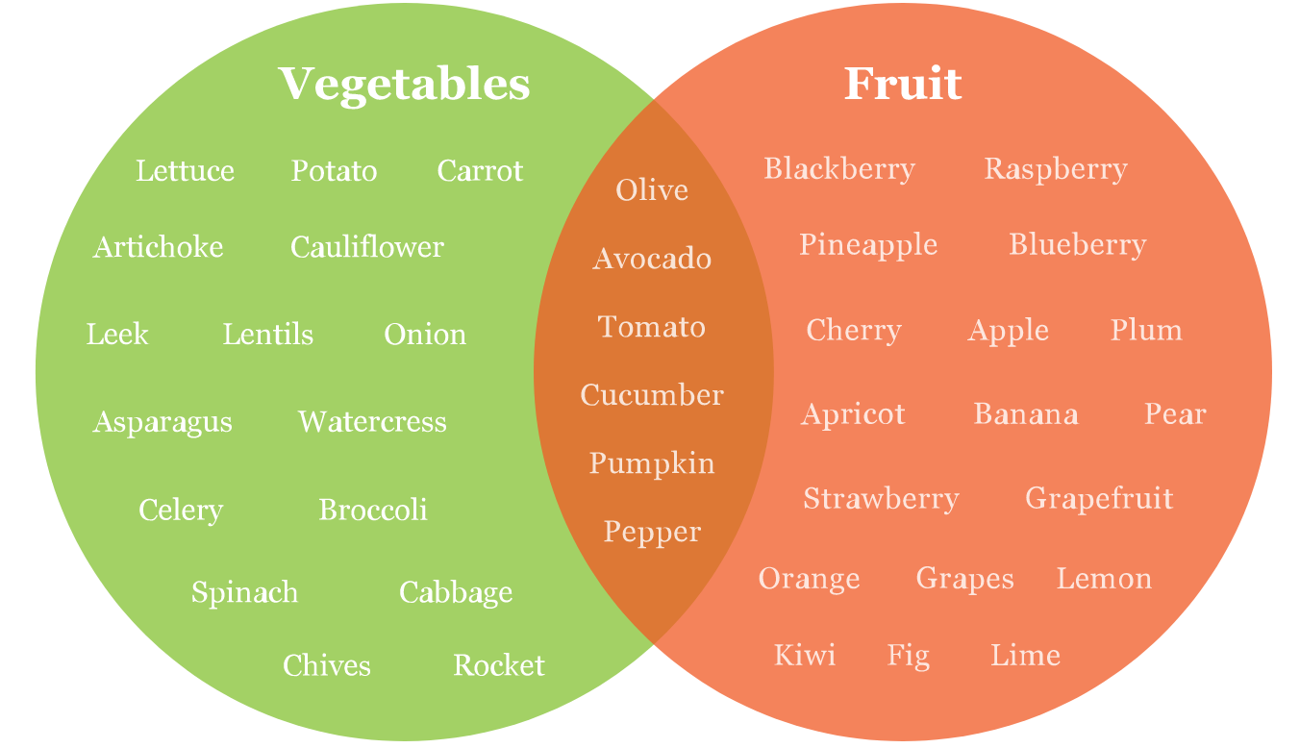
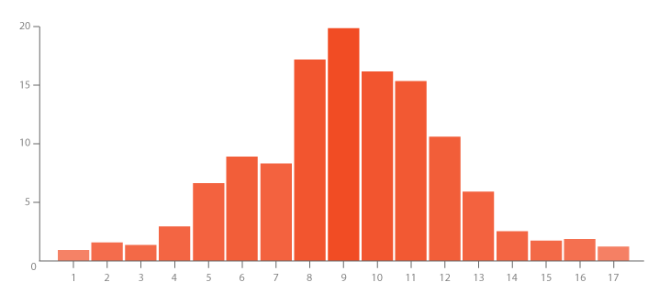
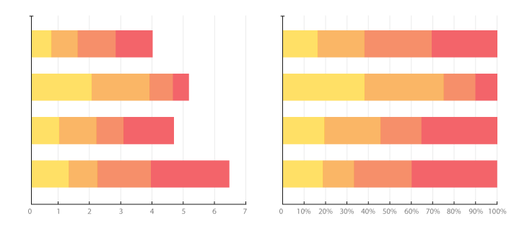
Categories
Multidimensional Data Visualizations
Drill down and filter the data.
This is the best type of visual to use:
Break down your data in a number of ways to capture the key takeaways.
Most vibrant and eye-catching visualization type.
Examples of multidimensional data visualizations
Scatter plots
Pie charts
Venn diagrams
Stacked bar graphs
Histograms
Pie
Venn
Histogram
Stacked bar
Data Visualization

Slide 10
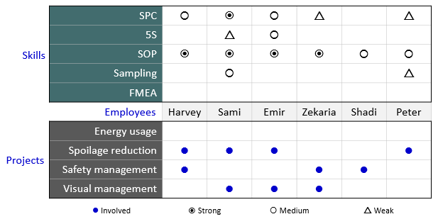
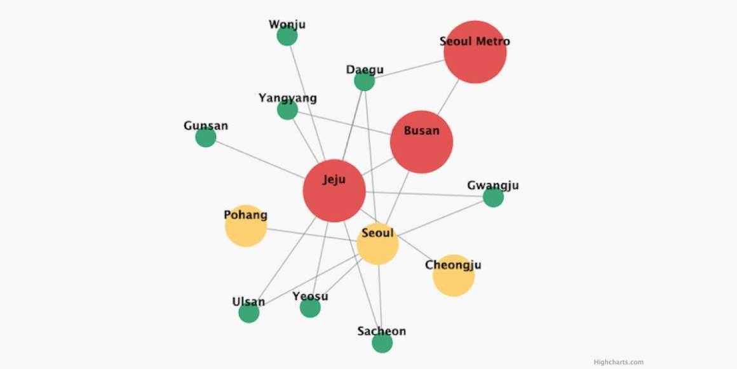
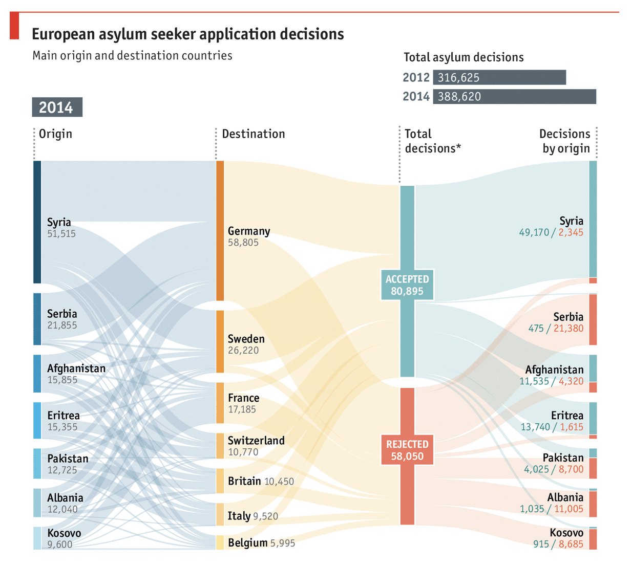
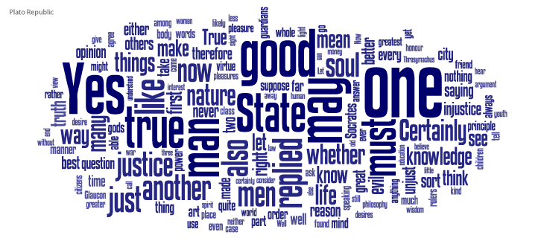
Categories
Network Data Visualizations
Show relationships between entities—nodes (the circles on the visualization) and links (the lines that connect to the nodes)—without the use of words.
Examples of network data visualizations
Matrix chart
Node-link diagrams
Word clouds
Alluvial diagrams
Matrix
Alluvial
Word clouds
Node-link
Data Visualization

Slide 11
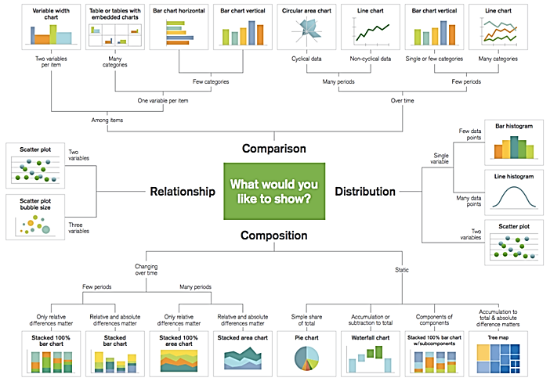
Purposes
Chart Purposes
Comparison: are you comparing one or more variable?
Relationship: are you showing a connection or correlation between two or more variables?
Composition: are you showing a change over time and/or parts to a whole?
Distribution: are you attempting to identify outliers and trends?
Data Visualization

Slide 12
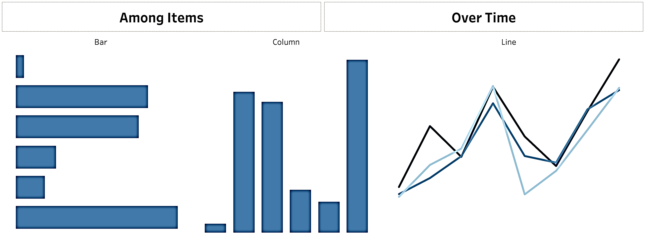
Purposes
Comparison
Designed to set one variable apart from another.
Display how the two variables interact with each other.
Compare items.
Show differences over time, over regions.
https://datavizcatalogue.com/
Examples
Voting, Migration, Sales, etc.
Data Visualization

Slide 13
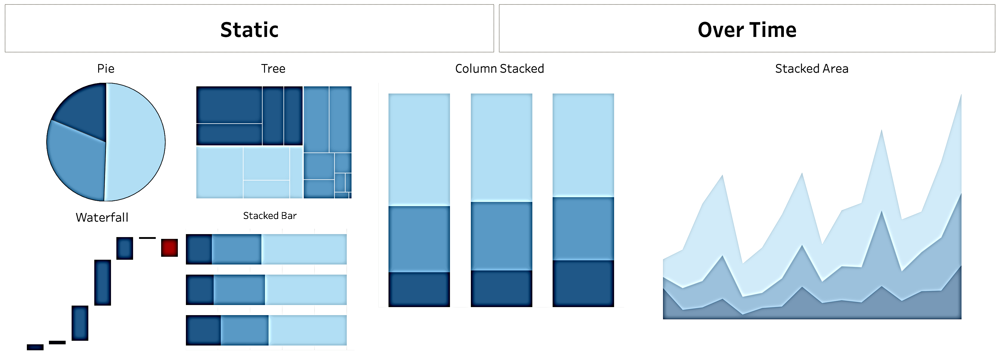
Purposes
Composition charts
Display parts of a whole and change over time.
Not recommended: if must, use when comparing no more than 3 variables at a time.
Difficulties: Human are not as good at noticing area and angle, and those just so happen to be the two main aspects of a pie chart. (swag opportunity for participant)
Data Visualization

Slide 14
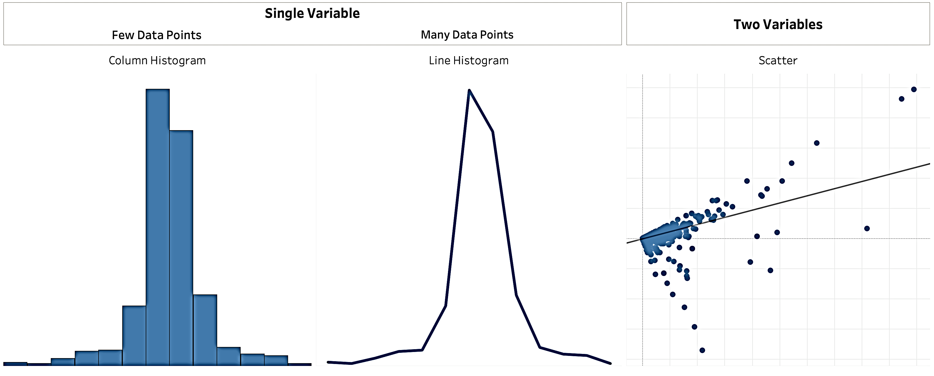
Purposes
Distribution Charts
Used to show how variables are distributed over time, helping identify outliers and trends.
Data Visualization

Slide 15
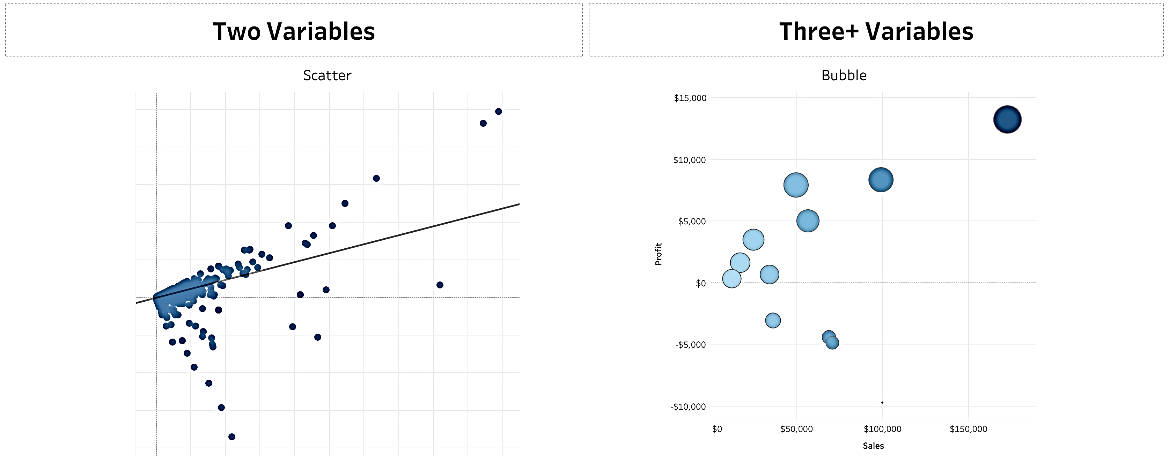
Purposes
Relationship Charts
Used to show a connection or correlation between two or more variables.
Data Visualization

Slide 16
Common Charts
Some Common Chart Types:
Line: Viewing trends in data over time.
Examples: Stock price change, website views change, revenue growth.
Bar: Comparing data across categories.
Examples: Products volume, traffic by origination sites, spending by departments.
Heat-map: Showing the relationship between two factors.
Examples: Segmentation analysis of target market, product adoption across regions, sales by shops.
Highlight Table: Providing detailed information on heat maps.
Examples: The percent of sales in different segments, sales numbers, population of cities in different years.
Tree-map: Showing hierarchical data as a proportion of a whole.
Examples: Storage usage across computer machines, comparing fiscal budgets between years.
Gantt: Showing duration over time.
Examples: Project timeline, duration of a machine’s use, availability of players on a team.
https://datavizcatalogue.com/index.html
Data Visualization

Slide 17
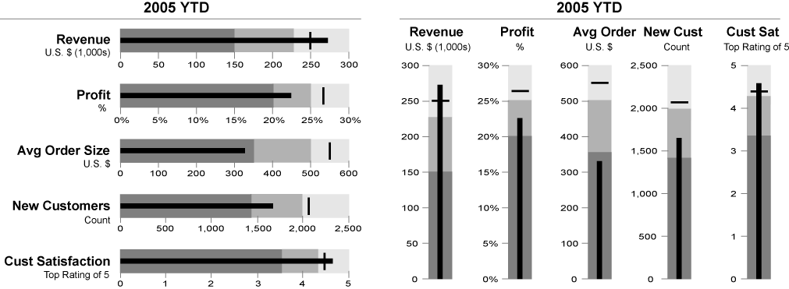
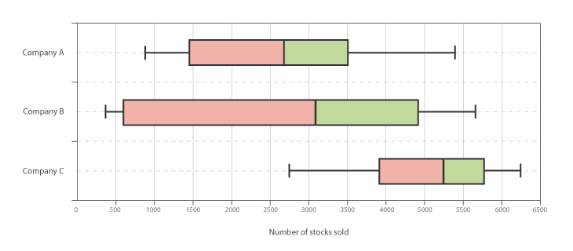
Common Charts
Some Common Chart Types:
Bullet: Evaluating performance of a metric against a goal.
Examples: Sales quota assessment, actual spending vs. budget, performance spectrum (great/good/poor).
Scatterplot: Investigating the relationship between different variables.
Examples: Male versus female of lung cancer at different ages, technology early adopters, shipping costs of different product categories to different regions.
Histogram: Understanding the distribution of the data.
Examples: Number of customers by company size, student performance on an exam, frequency of a product defect.
Symbol maps: Use for totals rather than rates.
Examples: Number of customers in different geographies.
Area maps: Use for rates rather than totals.
Examples: Rates of internet-usage in geographies, house prices.
Box-and-Whisker: Showing the distribution of a set of a data.
Examples: data skewed and identifying outliers in the data.
Data Visualization

Slide 18
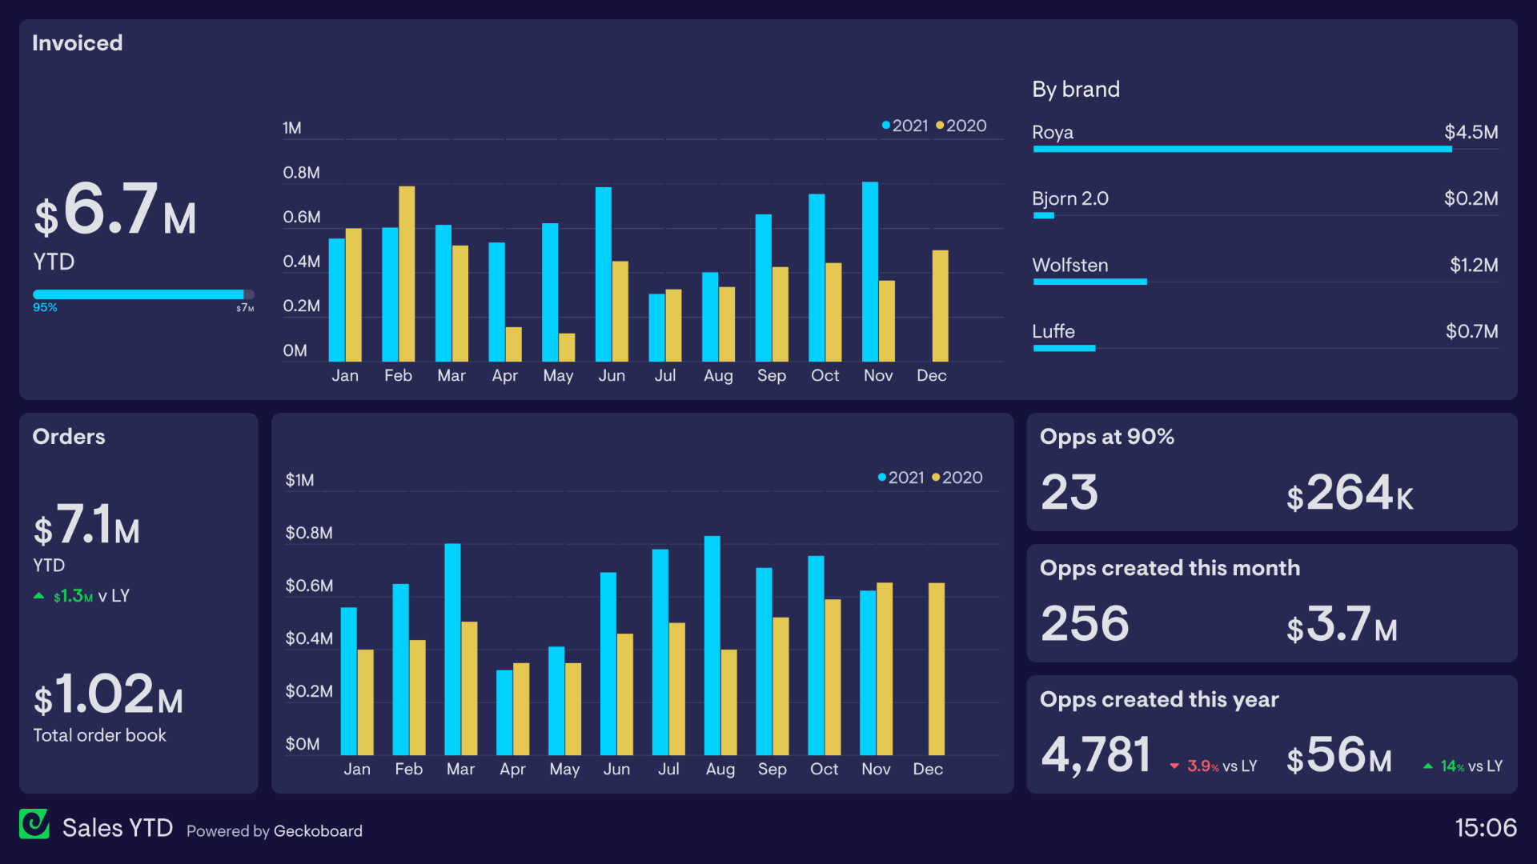
Dashboard
A dashboard is a visual display of the most important information needed to achieve one or more objectives; consolidated and arranged on a single screen so the information can be monitored at a glance.
Explanatory:
- Answers Direct Questions
- Delivers Information
- Often Static
Data Visualization

Slide 19
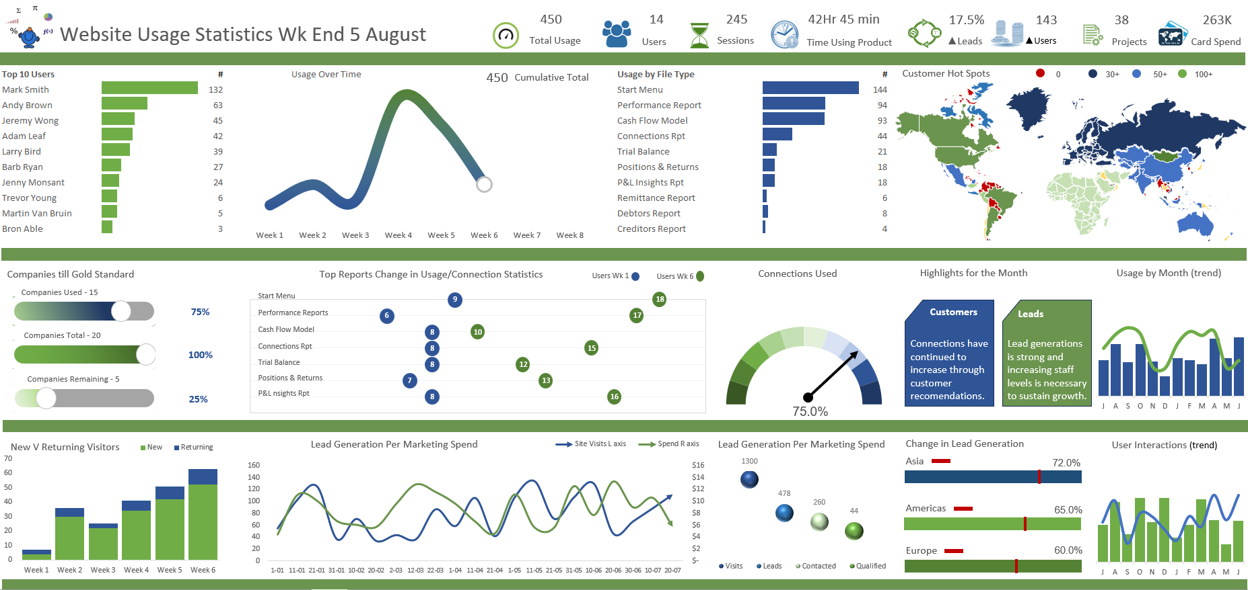
Dashboard
What makes a good dashboard?
Answers a set of questions
Follows a flow and invites interactivity.
Condensed; primarily in the form of summaries and exceptions.
Specific to and customized for the dashboard’s audience and objectives.
Provides appropriate text for clarity and direction, if needed
Makes strategic use of color.
The 5 second test.
Does your dashboard pass the 5 second test?
Most important view is on top or top left
Legends are near their views
Avoid multiple color schemes
Uses 5 or fewer views (charts)
Data Visualization

Slide 20
Dashboard
1. Answers a Set of Questions
✅ A good dashboard is not just a collection of charts—it must answer specific business or analytical questions. 📌 Example: A sales dashboard should answer:
Which product category generates the most revenue?
What is the current sales trend compared to last year?
Are there any regions underperforming?
2. Follows a Flow & Invites Interactivity
✅ The dashboard should follow a logical sequence that guides the user’s attention from general insights to details. ✅ It should also allow filters, drill-downs, and interactions to explore deeper insights. 📌 Example: A financial dashboard could allow users to click on a department to see its specific budget breakdown.
Data Visualization

Slide 21
Dashboard
3. Condensed & Summarized (Focus on Key Insights)
✅ Instead of overwhelming users with too much data, a good dashboard presents summaries and exceptions (outliers, trends, alerts). 📌 Example: A marketing dashboard should highlight:
Overall campaign performance (not every single campaign detail).
Outliers (campaigns that performed significantly better or worse than expected).
4. Customized for the Audience & Objectives
✅ The design and content should match the audience’s needs. 📌 Examples:
Executives: Need high-level KPIs and strategic insights.
Analysts: Need more granular, drill-down data.
Sales Teams: Need real-time performance metrics.
Data Visualization

Slide 22
Dashboard
5. Provides Appropriate Text for Clarity
✅ Sometimes, a few labels, descriptions, or annotations help users interpret the data correctly. 📌 Example: Instead of just showing a revenue growth line chart, add a note: 📢 "Revenue increased by 15% this quarter due to higher sales in Europe."
6. Makes Strategic Use of Color
✅ Color should highlight important insights but not overwhelm the viewer. 📌 Best Practices:
Green = Positive trends (e.g., profit growth).
Red = Alerts or problems (e.g., sales decline).
Neutral Colors = Background information (e.g., light gray for secondary data).
Data Visualization

Slide 23
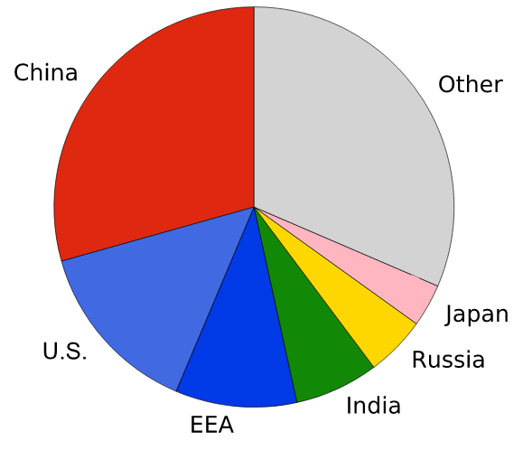
Visual Practices
Best visual practices: there aren’t any hard and fast rules, such as “do this and never do that”, It isn’t a black and white process.
There are, however, guidelines that make sense most of the time. Many of these derive from studies done on how we as humans process things like color, shape, and size.
Good and Bad Visualization
Charts and Dashboards
Is “China” bigger than “Other”?
Pie charts are best used when there are 2-3 items that make up a whole. Any more than that, and it’s difficult for the human eye to distinguish between the parts of a circle.
Data Visualization

Slide 24
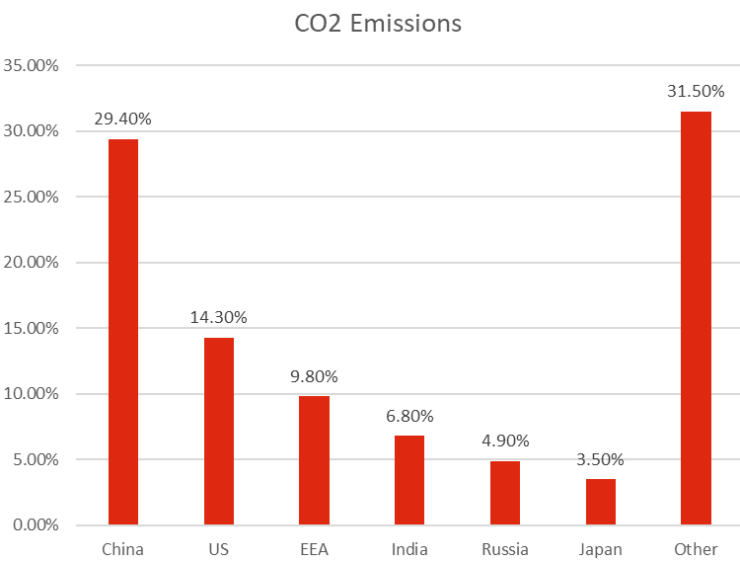
Visual Practices
How about Bar chart ?
Eyes are more sensitive to length of bars than parts of a circle.
Data Visualization

Slide 25
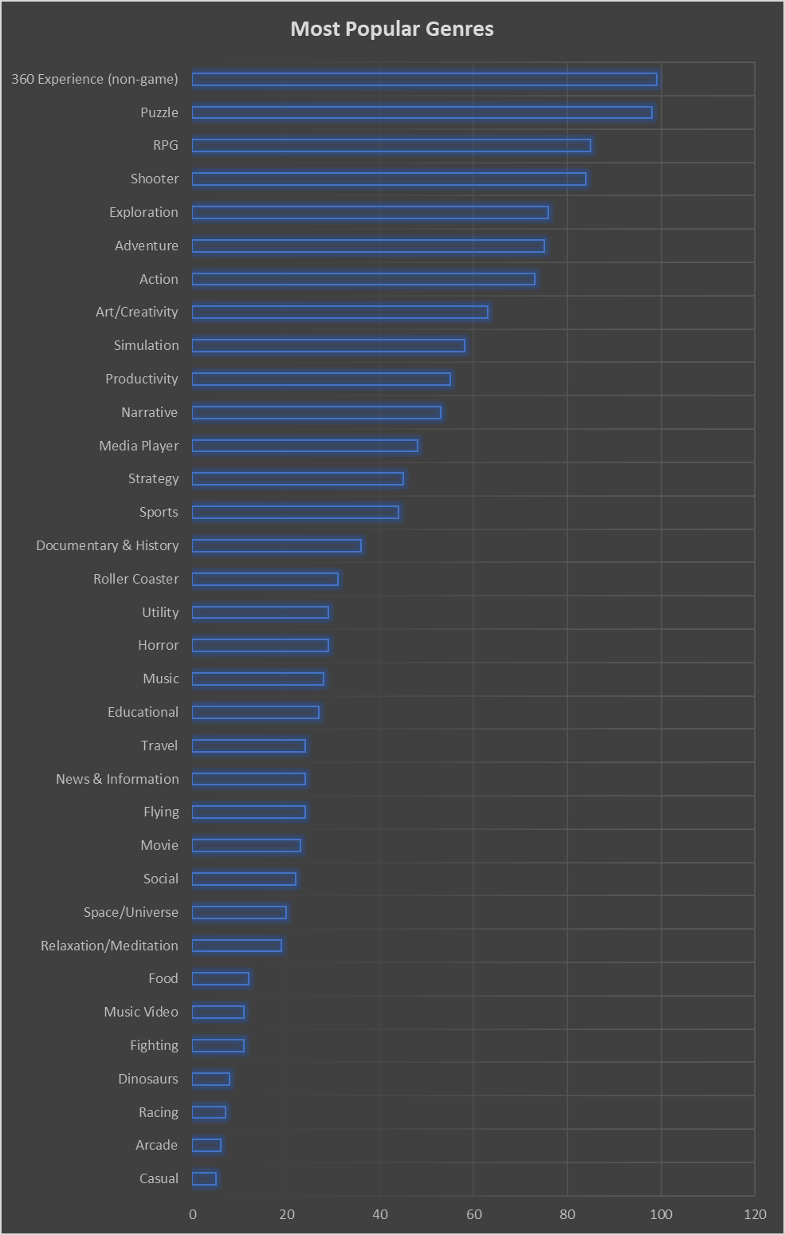
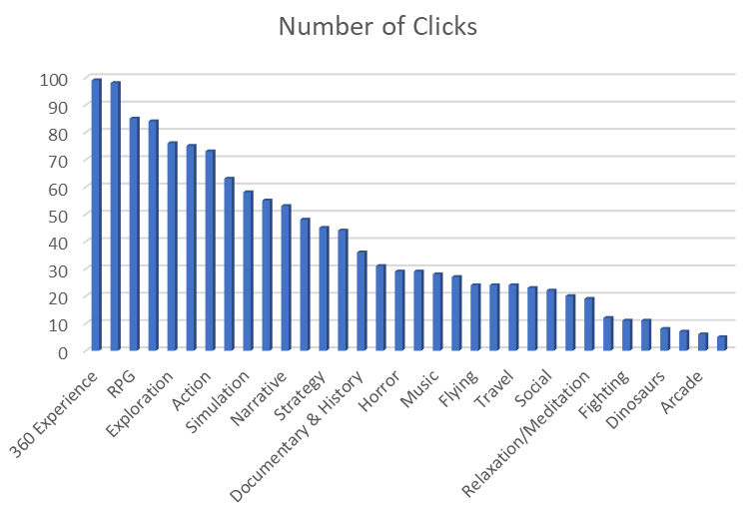
Visual Practices
Bad example #2: Horizontal bar charts
Horizontal bar charts suffer from the same issue as pie charts: once there are too many categories, you run out of space to include text and it becomes hard to digest
Data Visualization

Slide 26
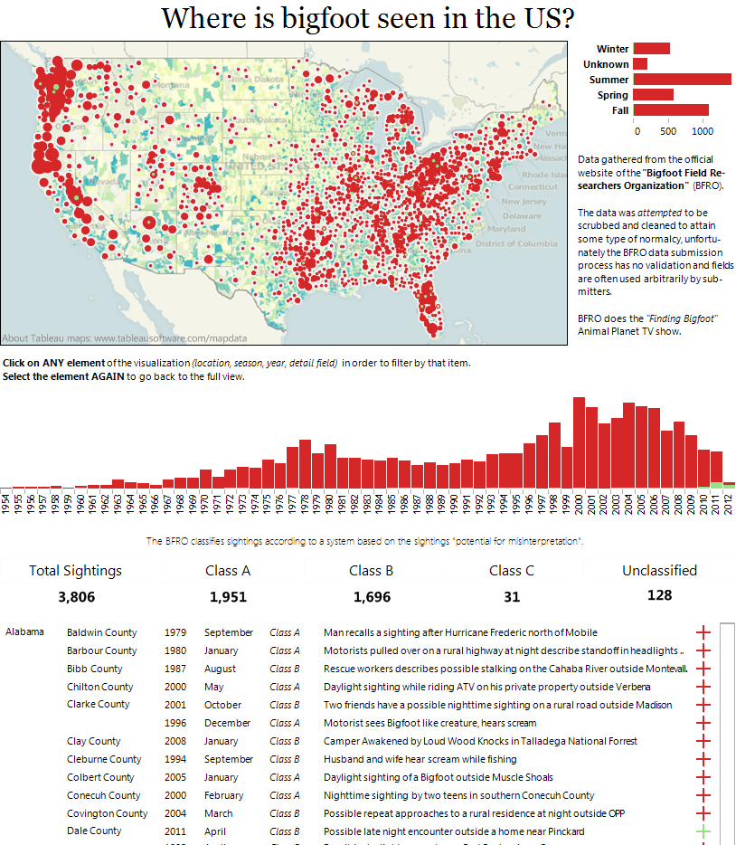
Layout
Layout Guidelines: Top-left Layout, Emphasizing Box, Inverted Pyramid, Flow Guidelines.
Top-left Layout: the most important thing should be in the top left: the headline, the instructions, the most important chart.
The message is the geographical distribution
The logo should be in the bottom right!
Data Visualization

Slide 27
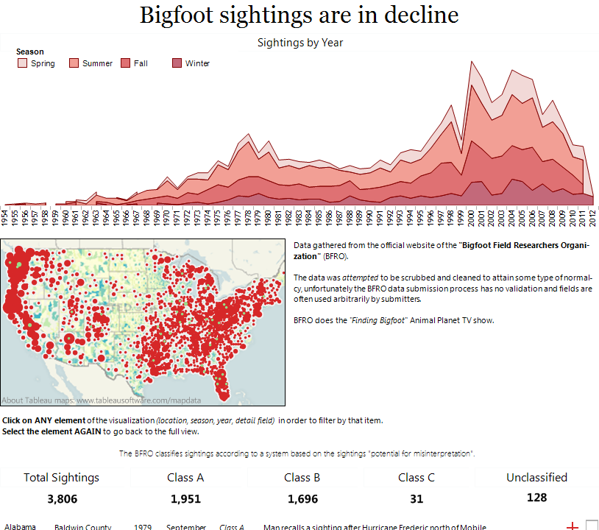
Layout
Different Layout: time series to the top, and included the season data too. With this and the title, the dashboard’s message is completely different.
Data Visualization

Slide 28
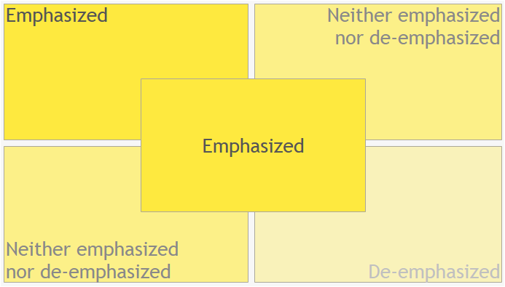
Layout
Emphasizing Box:
Data Visualization

Slide 29
Layout
Inverted Pyramid Metaphor:
Used by journalist to illustrate how information should be prioritized and structured in text.
The widest part at the top represents the most substantial, interesting, and important information.
The tapering lower portion illustrates that other material (of diminishing importance).
Most Newsworthy Info
Who? What? When? Where? Why? How?
Important Details
This metaphor holds true for a dashboard – the most important, newsworthy information should be at the top and the importance of information should filter down.
Other General Info
Data Visualization

Slide 30
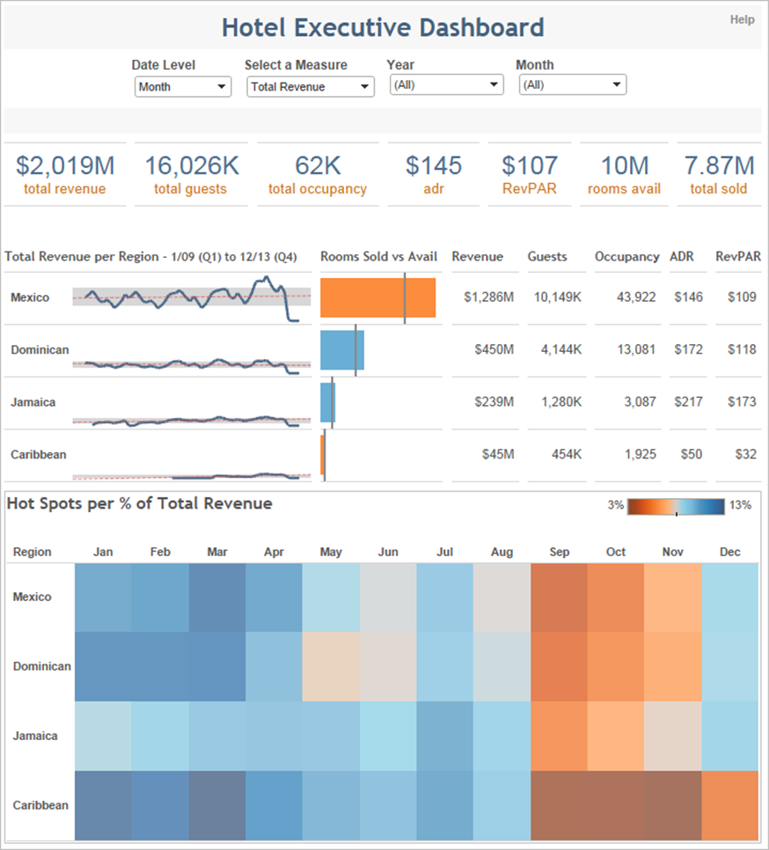
Layout
Flow Guidelines
Filters at the top, so user knows when and how to start interacting.
Most important information at the top and centered.
Starts with the highest level and works down to more precise details.
No more than 4-5 worksheets.
Data Visualization

Slide 31
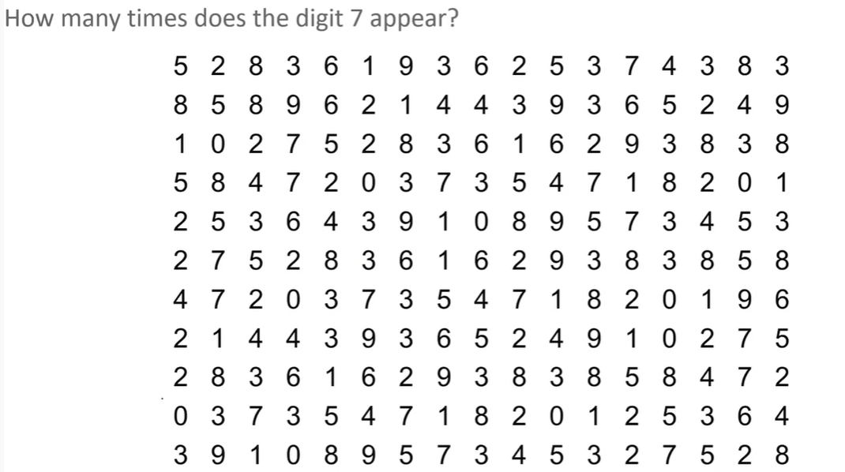
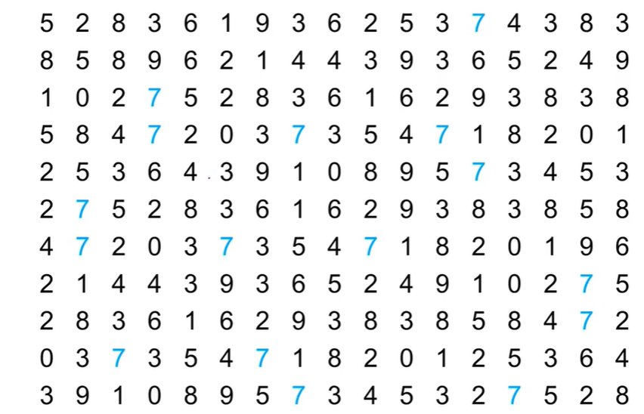
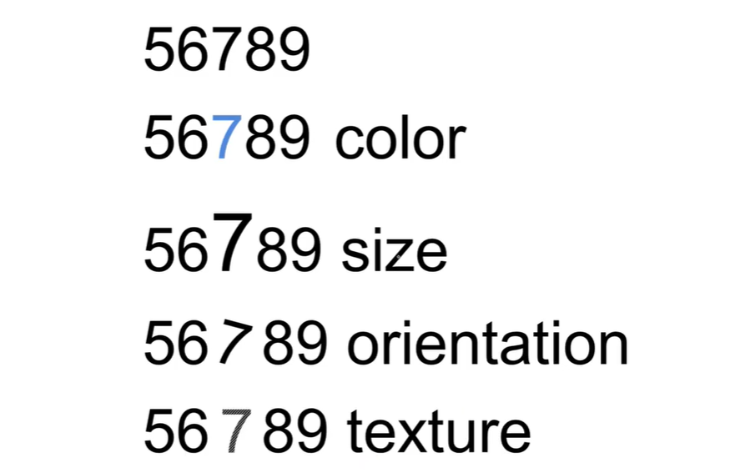
Pre-attentive Principles
Pre-attentive Principles: important aspect of the human visual system and a powerful component of data visualization. If used correctly, it allows you to create visualizations that not only get the attention of the user but also transmit information in the fastest, most effective and efficient way.
Data Visualization

Slide 32
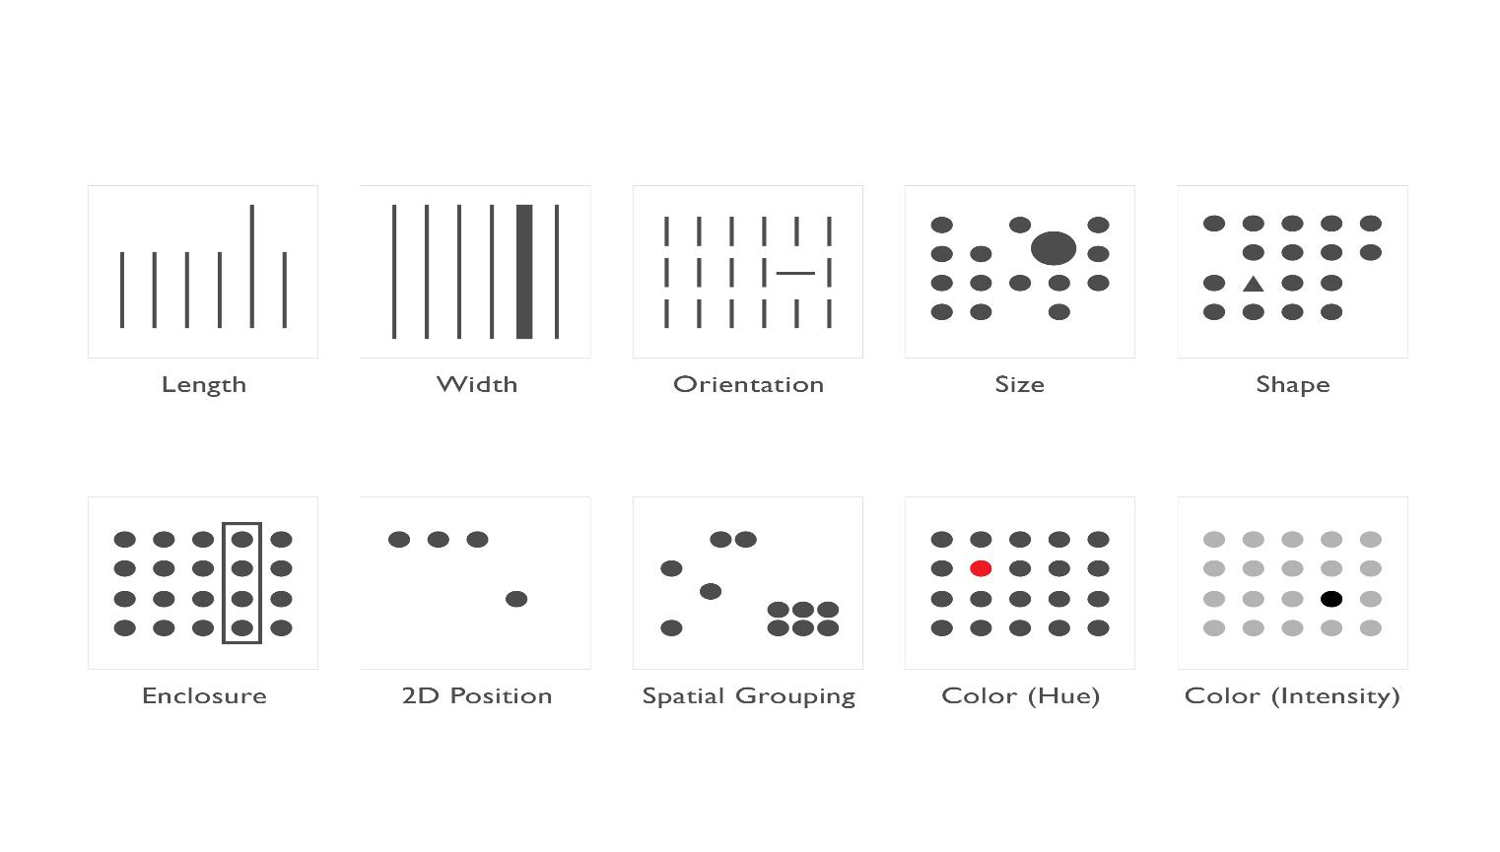
Shapes and Colors
Pre-attentive Principles:
Length | Width | Orientation | Size | Shape
Enclosure | 2D Position | Grouping | Color (Hue) | Color (Intensity)
Data Visualization

Slide 33
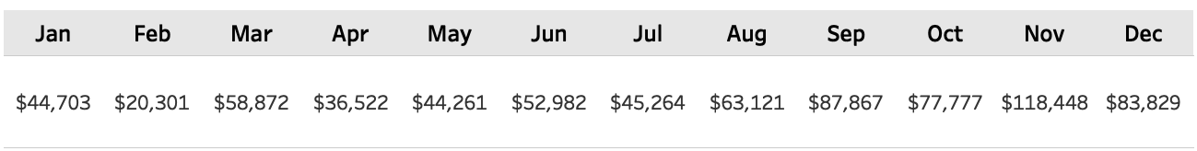

Shapes and Colors
Using pre-attentive principles in the dashboards allow the end user to process information faster and draw clear distinctions in the data (gives the ability to say more with less).
These lines of distinction can be implemented using size, shape, width, or color.
By incorporating a few key pre-attentive attributes (like shape and color), you will be able to effectively draw your eyes to the key places on the page.
Example
Data Visualization

Slide 34
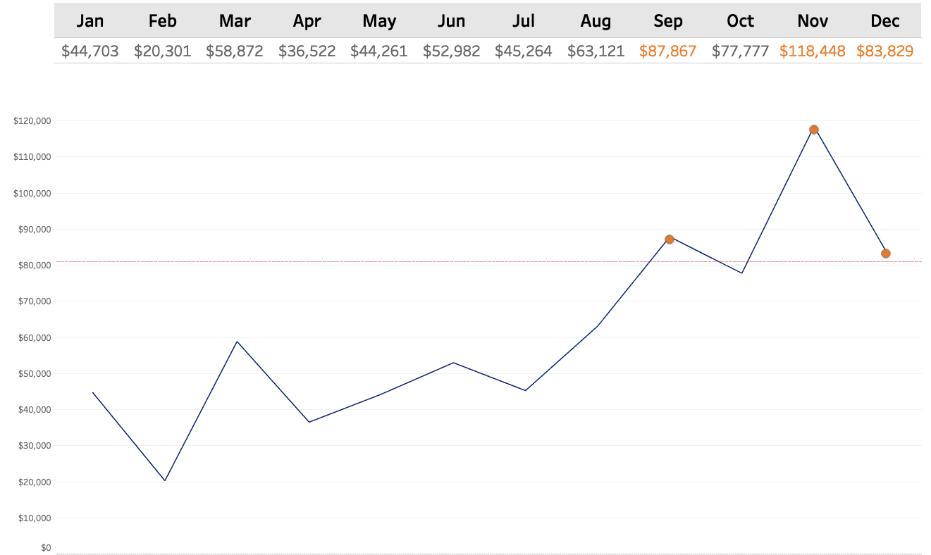

Shapes and Colors
Solution
Data Visualization

Slide 35

Shapes and Colors
Form: The outward appearance of something as distinguished from its substance.
Hue: property that becomes apparent when light falls on an object and by which things that are identical in form can be distinguished.
Example: Two images that consist of the same two shapes and two colors but are organized using different pre-attentive attributes.
Conclusion: color is easier to distinguish than shape.
Data Visualization

Slide 36

Shapes and Colors
By incorporate too many attributes, the end users will be overstimulate with too much information → the message can get lost in translation
Data Visualization

Slide 37

Colors
The color wheel helps understanding how colors related to each other.
Colors next to each other share similar values (used for flow and association)
Complementary colors are any two colors which are directly opposite each other, such as red and green and red-purple and yellow-green (used for contrast).
Triadic colors are used for balance.
Data Visualization
Notes:
Triadic (three)

Slide 38

Colors
Color theory is the study of how colors work together and how they affect our emotions and perceptions.
Color theory is like a toolbox for artists, designers, and creators to help them choose the right colors for their projects.
Color theory enables you to pick colors that go well together and convey the right mood or message in your work.
Data Visualization

Slide 39

Colors
HSB Color is comprised of three components: hue, saturation, and brightness.
Hue: is what you find on the color wheel – it’s what we think of when we hear the word ”color”. It’s the red, it’s the green, it’s the turquoise.
Saturation the intensity of the color.
Brightness: how much the “lightbulb” is turned on.
There are three ways you can saturate the color of your chosen Hue. You can add grey and change its Tone, Black and change its shade, or White and change its tint.
Hue
Colors of the same hue and saturation, but of different lightness, are called tints and shades.
Colors of the same hue and lightness, but of different saturation, are called tones.
Tone
Shade
Tint
Data Visualization

Slide 40

Colors
https://colors.dopely.top/color-toner/4da1d2-shades-40
Data Visualization

Slide 41



Colors
For qualitative/categorical data, the differences are represented by changing the hue → Color wheel is used to choose hues that are distinct from one another (Limit the number of hues to 7).
Quantitative or numerical data, the changes are reflected by the tone (primarily saturation).
Tips:
Always use the same color to represent the same meaning throughout all of your vizzes.
It’s good to note that color is not a good visual encoder when trying to illustrate small quantitative differences; if you want to show small variate, consider using length or position for this.
Quantitative / Numerical
Relationship /Sequence
Data Visualization

Slide 42

Colors
Pre-Established Common Colors Meaning
Data Visualization

Slide 43


Title
A concise, descriptive title can make a huge difference in garnering attention and making a chart more memorable.
Tips:
The title should get inside the users brain and spark interest (excited, scary, be controversial, drive curiosity, invoke emotion, educated or be intriguing).
Data Visualization

Slide 44

Title
Think about everywhere you have text on your dashboard – are your charts and axis' labeled appropriately?
Tips for improving tooltip:
Use a proper font
Identify the most important part of the tool tip and make it your title
Change measure names/values to make them specific and understandable
Include proper units
Remove command prompts
Data Visualization

Slide 45
Common Mistakes
There are a number of visual elements of every data visualization, and a handful of common mistakes people make when creating them:
Poor color schemes
Distracting fonts
Many different fonts
Sloppy alignment
Vertical or angled labels
Dark background colors
Thick borders or grid lines
Useless images and clip art
Lazily accepting most software defaults
Data Visualization

